Slide 1
Big Oracal data
and
Big table (Google big table)

Slide 2
Oracle Big Data
Oracle is the first vendor to offer a complete and integrated solution to address the full spectrum of enterprise big data requirements. Oracle’s big dua strategy is centered on the idea that you can extend your current enterprise information architecture to incorporate big data. New big data technologies, such as Hadoop and Oracle NoSQL. Database, run alongside your Oracle data warehouse to deliver business value and address big data requirements

Slide 3
Oracal big data
Oracle is the first vendor to offer a complete and integrated solution to address the full spectrum of enterprise big data requirements. Oracle’s big dua strategy is centered on the idea that you can extend your current enterprise information architecture to incorporate big data. New big data technologies, such as Hadoop and Oracle NoSQL. Database, run alongside your Oracle data warehouse to deliver business value and address big data requirements

Slide 4
Oracal big data
Oracle Big Data Service is an Oracle Cloud Infrastructure service designed for a diverse set of big data use cases and workloads. From short-lived clusters used to tackle specific tasks to long-lived clusters that manage large data lakes, Big Data Service scales to meet an organization’s requirements at a low cost and with the highest levels of security.

Slide 5
Oracal big Data
Oracle Big Data offers an integrated portfolio of products to help you organize and analyze your diverse data sources alongside your existing data to find new insights and capitalize on hidden relationships.

Slide 6
About Oracle Big Data Appliance
Oracle Big Data Appliance is an Oracle Engineered System. It is a big data platform optimized to capture and analyze the massive volumes of data generated by social media feeds, email, web logs, photographs, smart meters, sensors, and other devices. Oracle Big Data Appliance works with Oracle Exadata Database Machine, other Oracle Database platforms, as well as Oracle Exalytics In-Memory Machine. Together, these systems provide advanced analysis of all data types, with enterprise-class performance, availability, supportability, and security.

Slide 7
Oracle Big Data Appliance Rack Components
The Oracle Big Data Appliance consists of one or more racks of servers. Each rack includes network switches to connect to the appliance’s internal networks and to connect to the external data center network. Each rack is supported by two PDUs. The table below lists the components of an Oracle Big Data Appliance rack.

Slide 8
Software for Big Data Appliance
The Oracle Linux operating system and Cloudera’s Distribution including Apache Hadoop (CDH) underlie all other software components installed on Oracle Big Data Appliance. CDH is an integrated stack of components that have been tested and packaged to work together. CDH has a batch processing infrastructure that can store files and distribute work across a set of computers. Data is processed on the same computer where it is stored. In a single Oracle Big Data Appliance rack, CDH distributes the files and workload across 18 servers, which compose a cluster. Each server is a node in the cluster.

Slide 9
Acquiring Data for Analysis
Databases used for online transaction processing (OLTP) are the traditional data sources for data warehouses. The Oracle solution enables you to analyze traditional data stores with big data in the same Oracle data warehouse. Relational data continues to be an important source of business intelligence, although it runs on separate hardware from Oracle Big Data Appliance. Oracle Big Data Appliance provides these facilities for capturing and storing big data: Hadoop Distributed File System Apache Hive
Oracle NoSQL Database

Slide 10
Allocating Resources Among Services
You can allocate resources to each service—HDFS, YARN, Hive, and so forth—as a percentage of the total resource pool. Cloudera Manager automatically calculates the recommended resource management settings based on these percentages. The static service pools isolate services on the cluster, so that a high load on one service as a limited impact on the other services.

Slide 11
Organizing Big Data
Oracle Big Data Appliance provides several ways of organizing, transforming, and reducing big data for analysis: MapReduce Oracle Big Data Connectors Oracle R Support for Big Data

Slide 12
Analyzing and Visualizing Big Data
After big data is transformed and loaded in Oracle Database, you can use the full spectrum of Oracle business intelligence solutions and decision support products to further analyze and visualize all your data.

Slide 13
Best Practices
The Data Warehouse Insider blog site provides expert advice
on best practices for administering and using Oracle Big Data Appliance.

Slide 14
INTRODUCTION on BIG TABLE
Big table is a fully managed wide-column and key-value NoSQL database service for large analytical and operational workloads as part of the Google Cloud portfolio.
Big table can be used as the storage engine for large-scale, low-latency applications and data processing and analytics with high throughput.
Cloud Big table is a sparsely populated table that can scale to billions of rows and thousands of columns, enabling you to store terabytes or even petabytes of data. A single value in each row is indexed; this value is known as the row key. Big table is ideal for storing large amounts of single-keyed data with low latency.

Slide 15
Architecture
Client library
Single master server
Tablet servers

Slide 16
Bigtable Master
Assigns tablets to tablet servers
Detects addition and expiration of tablet servers
Balances tablet server load
Handles garbage collection
Handles schema changes

Slide 17
Bigtable Tablet Servers
Each tablet server manages a set of tablets
Typically between ten to a thousand tablets
Each 100-200 MB by default
Handles read and write requests to the tablets
Splits tablets that have grown too large

Slide 18
Tablet Assignment
Master keeps track of:
– Set of live tablet servers
– Assignment of tablets to tablet servers
– Unassigned tablets
Each tablet is assigned to one tablet server at a time
– Tablet server maintains an exclusive lock on a file in Chubby
– Master monitors tablet servers and handles assignment
Changes to tablet structure
– Table creation/deletion (master initiated)
– Tablet merging (master initiated)
– Tablet splitting (tablet server initiated)

Slide 19
Bigtable architecture
The following diagram shows a simplified version of Bigtable's overall architecture:
As the diagram illustrates, all client requests go through a frontend server before they are sent to a Bigtable node.

Slide 20
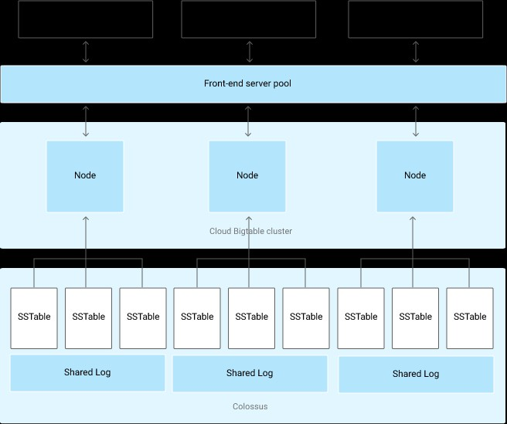

Slide 21
Bigtable architecture
Each node in the cluster handles a subset of the requests to the cluster. By adding nodes to a cluster, you can increase the number of simultaneous requests that the cluster can handle. Adding nodes also increases the maximum throughput for the cluster. If you enable replication by adding additional clusters, you can also send different types of traffic to different clusters. Then if one cluster becomes unavailable, you can fail over to another cluster.

Slide 22
Bigtable Applications
Data source and data sink for MapReduce
Google’s web crawl
Google Earth
Google Analytics

Slide 23
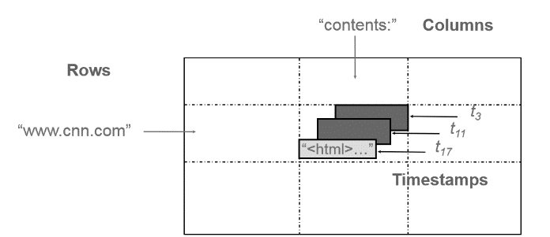
DATA MODEL
Bigtable is a sparse, distributed, multilevel map which indexed by a combination of row ,column and timestamp values.

Slide 24
DATA MODAL
Above figure demonstrates how Bigtable can store multiple values (instances) of data in a single cell using timestamp, it shows multiple versions of html pages stored at different values of timestamp. This feature makes Bigtable a truly multidimensional map.

Slide 25
Row
Row keys are arbitrary strings up to 64 KB of size. Multiple contiguous rows grouped together is called a tablet.
One tablet can hold up to 100–200 MB of data.

Slide 26
COLUMN
Column keys are also strings having a two level naming structure which has column family and optional qualifiers. Column name → family : optional_qualifier
Column family are the basic unit of access control.

Slide 27
TIMEsTAmPS
Since Bigtable can store multiple versions of data in a cell it uses timestamp values to index these multiple versions. Timestamp is a 64-bit integer value. This timestamp value can be set by the Bigtable or be explicitly set by the clients. Timestamps make it possible for clients to access most recent values or use values among a specific range of timestamp

